Slide 1
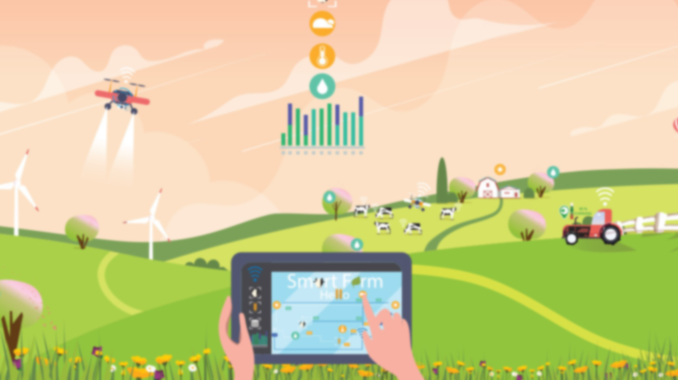
The role of precision farming and digitalization in climate change mitigation
Professor Svetla Yancheva
Associated proressor Boryana Ivanova
Associated Professor Rositsa Beluhova-Uzunova
Chief assistant professor dobri dunchev
Agricultural University-Plovdiv

Slide 2
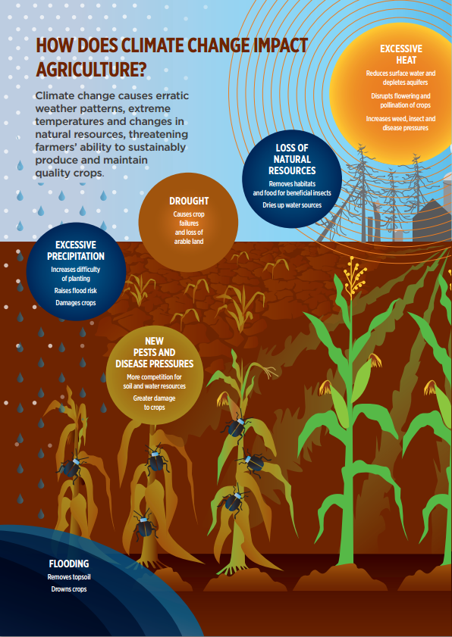
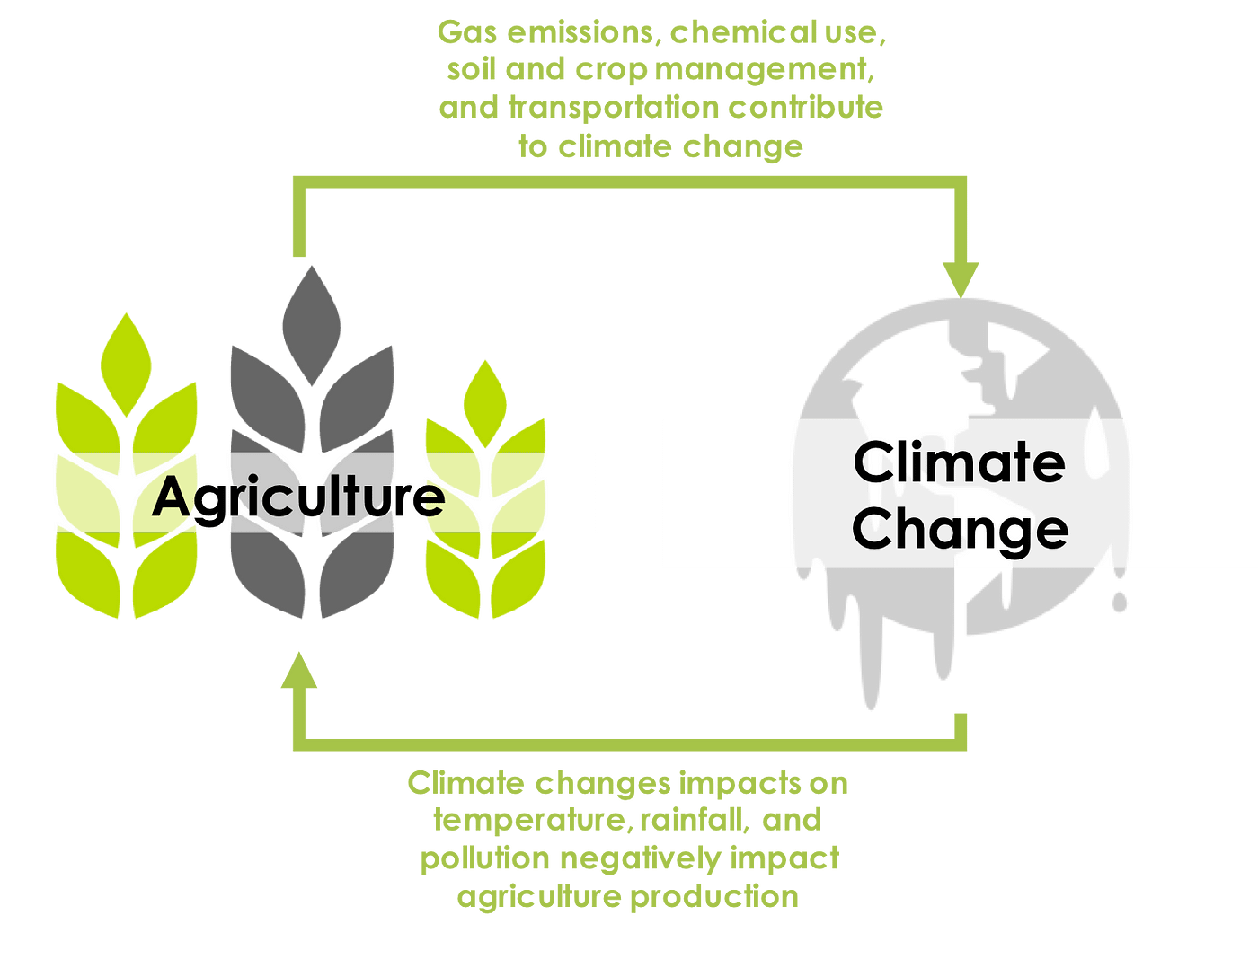

Slide 3
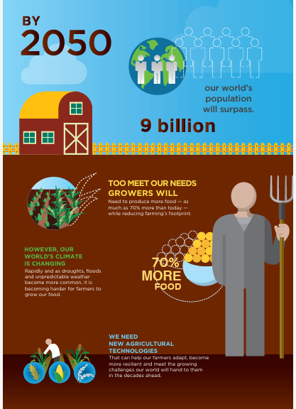
Future global challenges

Slide 6
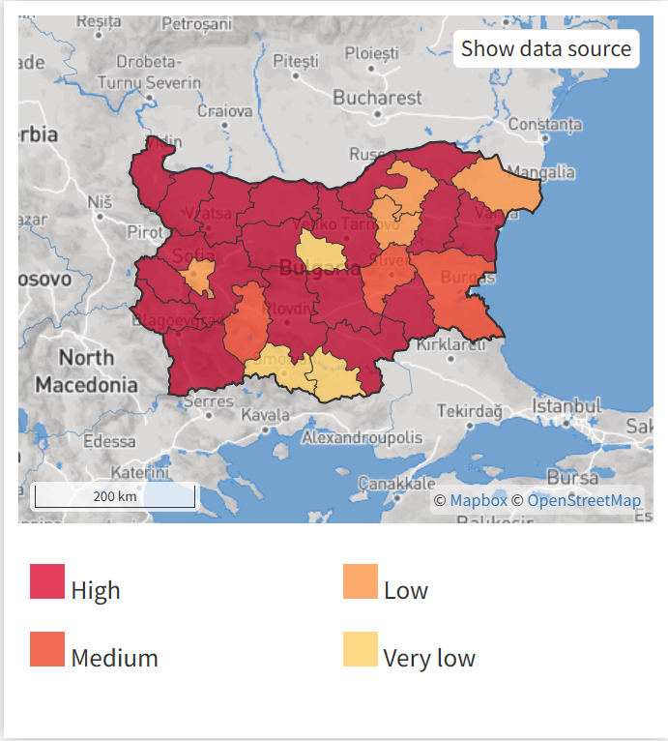
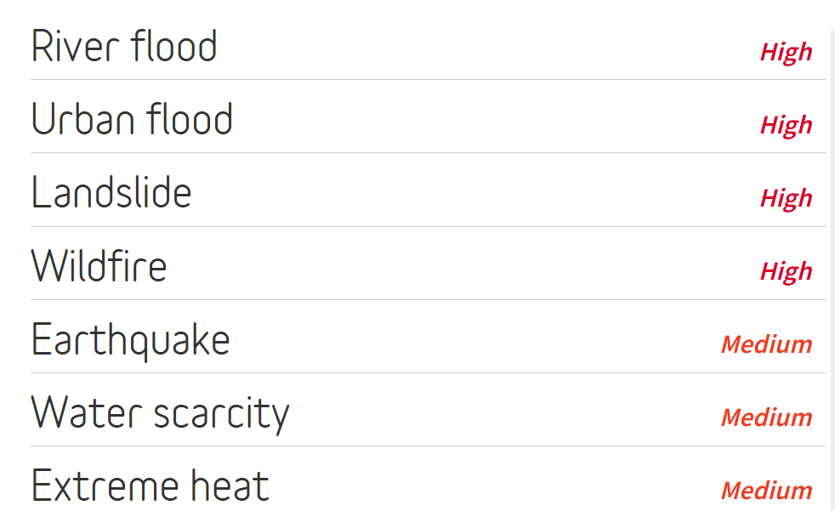
Bulgaria- climate change risks
River flood risks
Source: Think Hazard

Slide 7
Adaptation strategies
The use of more efficient irrigation systems is needed because of the need for tighter water management practices to counter increased demand. For orchards and vines, drip irrigation systems can be used to conserve water.
Expanding areas of the most important agricultural crops over new regions characterized by improved thermal and moisture conditions.
Utilization of a variety of cultivars and hybrids, especially long-maturing, high-productive cultivars and hybrids with better industrial qualities.
Biodiversity preservation versus. Cultivation of new agricultural crops grown with Mediterranean origin.

Slide 8
Survey in South Bulgaria
Survey - 60 farmers in South Bulgaria via Google forms
Period: December 2024-February 2025
Directions:
Implementation of precision technologies
Climate change awareness and precision technologies adoption
Precision farming contribution to climate change mitigation

Slide 9
Key characteristics of the farmers in the survey
35% of the farmers are between 18-25 years old
Education: Bachelor degree (50%), High school (25%)
Marital status: civil partnership (35%), single (29%)
Number of children in the family: no chilidren (47%), one child (25%)
Male: female – 60:40
Specialization: fruits and vegetables (47%), cereals (29%)

Slide 10
Level of awareness and information about the impact of climate change on agriculture (%)
Source: Own survey

Slide 11
Assessment of the impact of precision technologies on climate change mitigation (%)
Source: Own survey

Slide 12
Implementation of precision technologies (%)
Source: Own survey

Slide 13
Application of the precision technologies(%)
Source: Own survey

Slide 14
Plans for implementation of precision technologies in the future (%)
Source: Own survey

Slide 15
Assessment of the impact of precision technologies on agriculture climate resilience (%)
Source: Own survey

Slide 16
Assessment the impact of precision technologies on following objectives relative to SDG13 - Climate Action (%)-5-point Likert scale
Source: Own survey

Slide 17
Conclusions
Climate change poses a significant threat to the food system, food security, and human health by affecting crop yields, water availability, and soil quality.
Precision agriculture emerges as a key strategy for improving resource efficiency and reducing greenhouse gas emissions and environmental pressures.
A study of 60 farmers in Bulgaria’s South Central region highlights awareness of precision agriculture and its potential in climate change mitigation.
A strong correlation exists between farmers’ knowledge, education level, and age, influencing their perception of precision agriculture’s effectiveness.
Farmers widely acknowledge climate change’s impact on agriculture, particularly through droughts, high temperatures, and flooding.

Slide 18
Conclusions
Despite environmental awareness, the actual implementation of precision agriculture in Bulgaria remains limited.
A targeted national policy is necessary to promote innovation and the adoption of precision technologies in agriculture.
Financial support from national funds, the Common Agricultural Policy (CAP), and Horizon Europe should be mobilized.
Effective implementation requires enhanced institutional coordination and improved digital infrastructure.

Slide 19
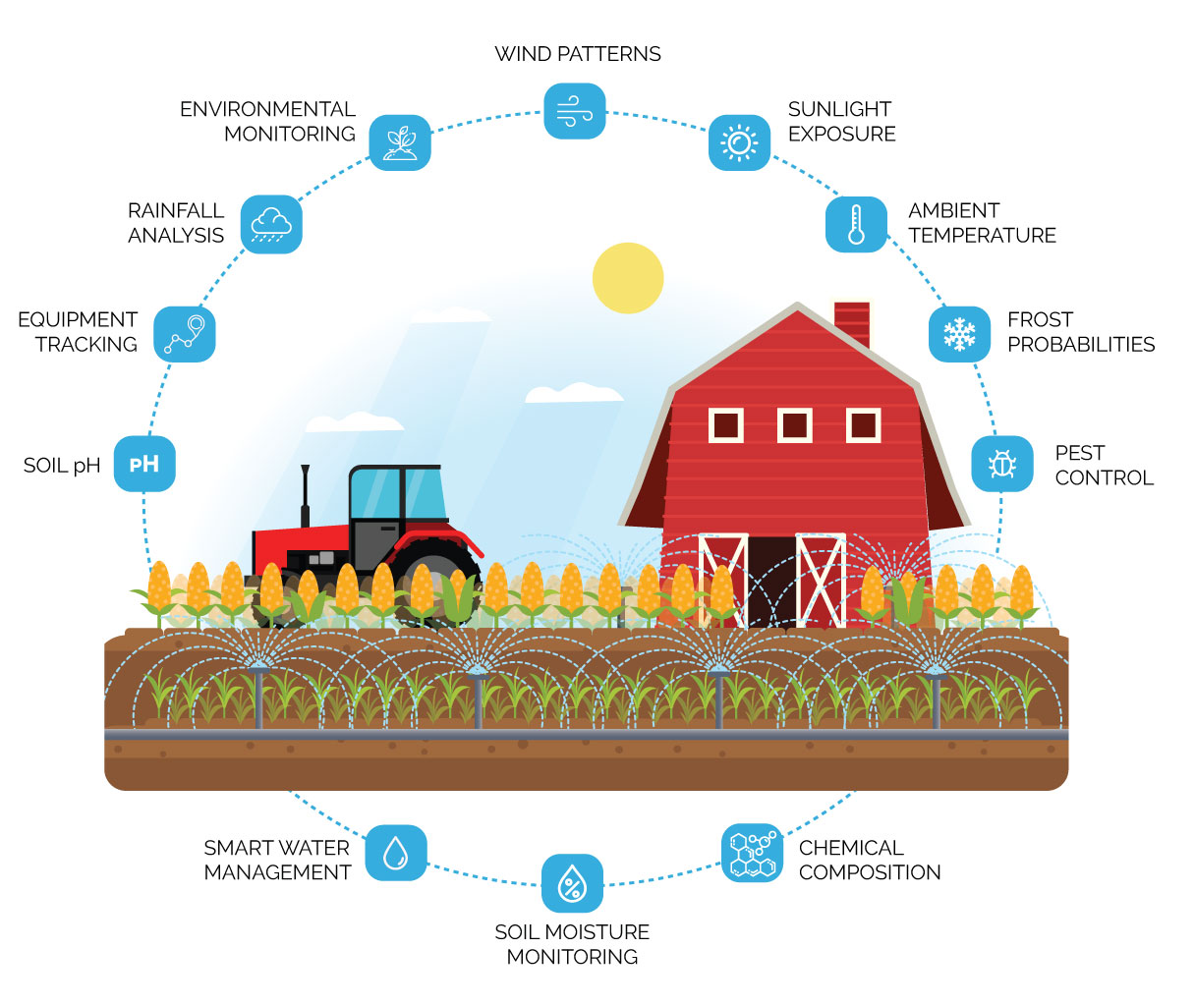
Thank you for your attention!
rbeluhovauzunova@gmail.com
yancheva_s@au-plovdiv.bg
borianaivanova@abv.bg
dobri.dunchev@yahoo.com

